Slide 1
HyperOpt
Optimization strategies
Dataset
Datetime variable
Treatment variable
Time Series
Dataset
Target variable
CausalImpact
Supervised
Treatment variable
Bayesian
DoWhy
PyMC
CausalNex
Dataset
Discrete
Hybrid
Continuous
Unsupervised
Pgmpy
Bnlearn

Slide 2
Dataset
Dataset
Datetime variable
Optimization strategies
Target variable
Treatment variable
Treatment variable
Supervised
Causal Discovery
Time Series
Bayesian
Manually by user
Dataset
Discrete
Hybrid
Continuous
Directed Acyclic Graph
(DAG)
Scoring
Methods
Parameter Learning
AIC
BIC
K2
Unsupervised
Structure Learning
(Causal Discovery)
BDS
BDUE
Discretize
Methods
Probabilistic Inference
Score-Based
Manually by user
Yi-Chun Chen
Search
Strategies
Independence
Test
Hill-Climbsearch
Exhaustive
Discrete datasets
Hybrid
Strategy
Constraint-
Based
TAN
ICALiNGAM
Chi2
Discrete datasets
Requires setting
Root/ class node
Naivebayes
DirectLiNGAM
Log likelihood
Chow-liu
Continuous and
hybrid datasets
Freeman tuckey
Overview for Causal Discovery
Bnlearn for Python

Slide 3
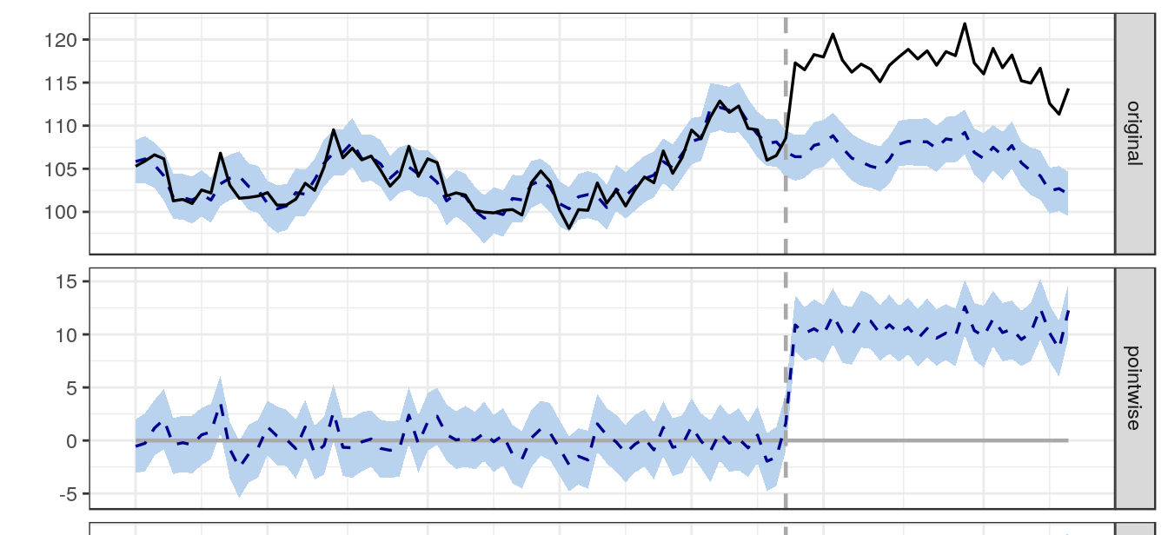
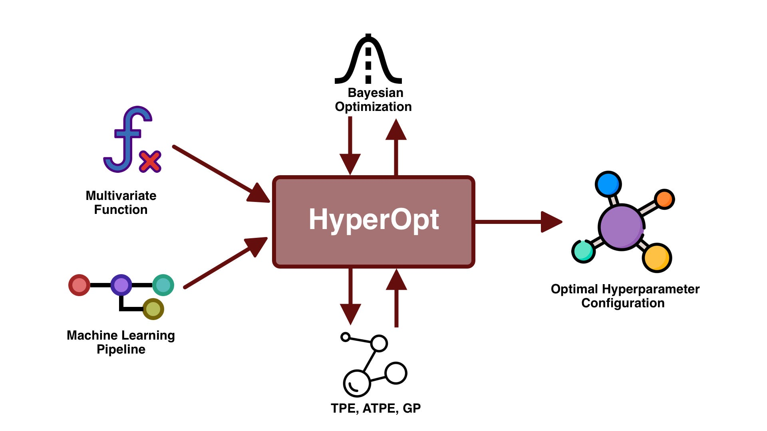
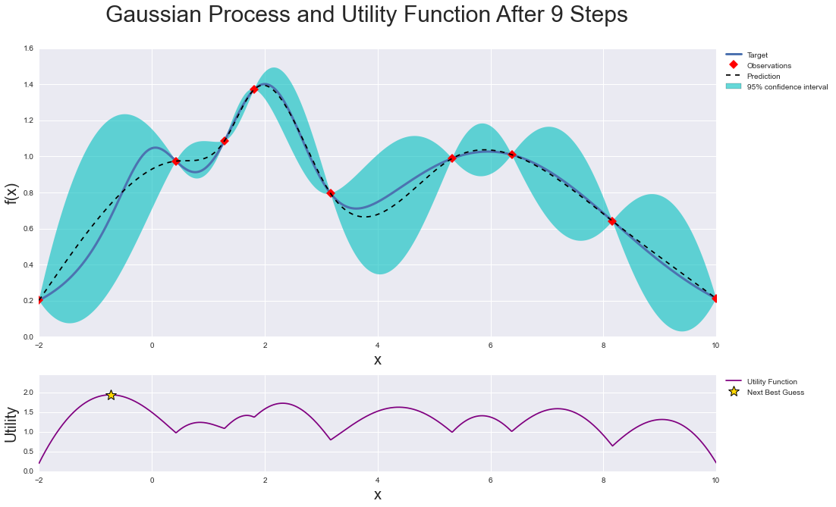

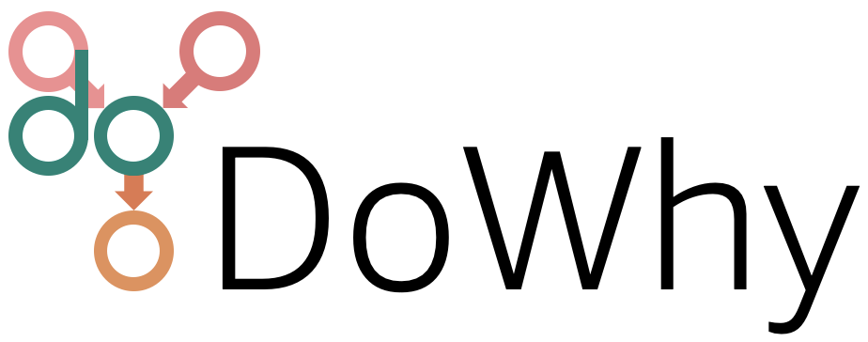
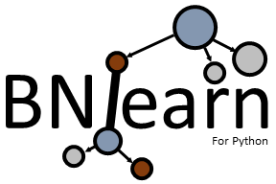

Optimization strategies
Time Series
Dataset
Datetime variable
BayesianOptimization
(Treatment variable)
CausalImpact
HyperOpt
Causal Discovery
(Supervised)
Bayesian
Dataset
Target variable
(Treatment variable)
Causal Discovery
(Unsupervised)
Dataset
Discrete
Hybrid
Continuous
Notes:
https://github.com/bayesian-optimization/BayesianOptimization
PyStan is a Python interface to Stan, a package for Bayesian inference.

Slide 4
Time Series
Optimization strategies
Dataset
Target variable
Treatment variable
Dataset
Causal Discovery
(Supervised)
Datetime variable
Treatment variable
Bayesian
Dataset
Manually by user
AIC
BIC
K2
Discrete
Hybrid
BDS
BDUE
Continuous
Directed Acyclic Graph
(DAG)
Discrete datasets
Requires setting
Root/ class node
Scoring
Methods
Parameter Learning
Unsupervised
Structure Learning
(Causal Discovery)
Score-Based
Approach
Discretize
Methods
Probabilistic Inference
TAN
Naivebayes
Chow-liu
Search
Strategies
Manually by user
Independence
Test
Yi-Chun Chen
Discrete datasets
ICALiNGAM
Distfit
Hill-Climbsearch
Hybrid Strategy
Constraint-Based
Approach
Exhaustive
DirectLiNGAM
Chi2
Continuous and
hybrid datasets
Log likelihood
Freeman tuckey
Overview for Causal Discovery
Bnlearn for Python

Slide 5
Bayesian
Manually by user
Dataset
Discrete
Hybrid
Continuous
Directed Acyclic Graph
(DAG)
Parameter Learning
Unsupervised
Structure Learning
(Causal Discovery)
Discretize
Methods
Probabilistic Inference
Score-Based
Manually by user
Yi-Chun Chen
Constraint-Based (PC)
Hybrid
Strategy
Overview for Causal Discovery
Bnlearn for Python

Slide 6
For 1000 days data is collected for these four variables
Sprinkler
Rain
Cloudy
Wet Grass
Yes?
No?
Yes?
No?
Yes?
No?
Yes?
No?

Slide 7
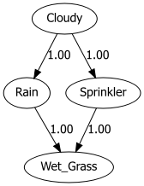
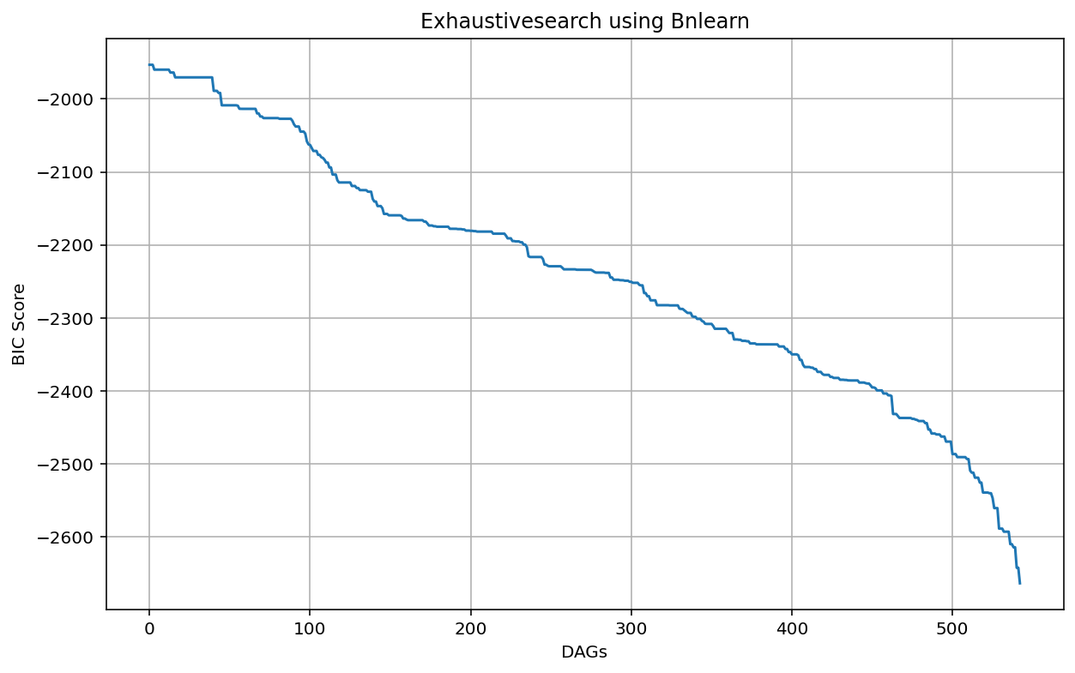
DAG with the best score
DAG with the worst score
Sprinkler
Rain
Cloudy
Wet Grass
DAG 1
Score: ?
543 unique DAGs

